Slide 1
2026-2027 Viral Respiratory Season
Influenza and RSV Surveillance
GA Infection Prevention Collaborative Webinar Series / Sayna Patel, MPH & Sam McChesney, MPH / Sept. 24, 2026

Slide 2
Disclosure
The presenter(s) have no financial conflicts of interest to disclose.​
This work is conducted as part of statewide viral respiratory disease surveillance by the Georgia Department of Public Health.
Data presented are for surveillance purposes and may be preliminary and subject to revision. ​

Slide 3
Objectives
Review current influenza and RSV surveillance and implications for the upcoming respiratory virus season
Identify key strategies to prevent and control disease transmission across healthcare settings
Strengthen approaches to early identification, testing, isolation, and management of patients and/or residents with respiratory illness
Highlight how facility-level reporting & surveillance contribute to Georgia's understanding of respiratory viral activity and inform statewide public health response

Slide 4
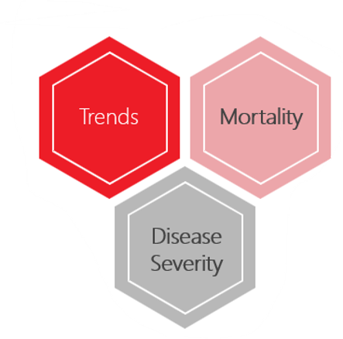
Viral Respiratory Disease - Surveillance Overview​
Notifiable Conditions: ​
  Outbreaks/Clusters: Caused by any VRD, with a focus on the Big 3​ (influenza, RSV, and COVID-19)​
  Associated Deaths (all ages): Influenza (flu) & Respiratory Syncytial Virus (RSV) ​
    COVID-19 pending transition to VRD team
    Cases: Novel Flu A​
EPI Surveillance:​
  Trends: Flu, RSV, COVID-19, Human Metapneumovirus (hMPV), Rhinovirus and Enterovirus, Human Parainfluenza Viruses (HPIVs), & Seasonal Coronavirus​

Slide 5
Reporting Guidelines - Deaths
In Georgia, all influenza, RSV, and COVID-19-associated deaths of all ages are notifiable under Rule 511-2-1-.02​
​
Those expected to report include:​
District Epidemiologists (DEs)​
Infection Preventionists (IPs)​
Hospital systems and healthcare personnel (HCP)
Medical examiners and coroners (where applicable)​
Licensed physicians, clinical laboratories, or designated officials of healthcare facilities (e.g., nursing homes, clinics, schools, mental health hospitals, correctional facilities)
Notes:
SAM: In Georgia Mandatory Reporters are required to report any notifiable condition to DPH by law. This includes all influenza, RSV, and COVID-19-associated deaths of all ages.
Mandatory reporters include: District epis, infection preventionists, hospital systems & healthcare personnel, medical examiners & coroners, and licensed physicians, clinical laboratories or designated officials of healthcare facilities (including nursing homes, schools, hospice and more)

Slide 6
Reporting Guidelines – Influenza & RSV Deaths
For surveillance purposes, RSV- or influenza-associated deaths are defined as:
  Resulting from a clinically compatible illness that was lab-confirmed to be RSV or influenza within 60 days of death*
  No period of complete recovery to baseline health between the illness and death
  Influenza or RSV does not need to be the primary or sole cause of death listed, but the death cannot be accidental or violent.
  *The positive lab test can be outside of the 60-day time frame if a continued illness, without recovery, results in death
Notes:
SAM: Now for the purposes of public health surveillance this is the case criteria for RSV and Influenza-associated deaths that mandatory reporters should follow when considering whether a death should be reported.
Most importantly, the patient must have a clinically compatible illness that was lab-confirmed to be RSV or Influenza within 60 days of death* (the positive lab test can be outside of the 60-day timeframe if a continued illness without recovery results in death. Postmortem test results also meet criteria.)
Secondly, no period of complete recovery to baseline health can occur between the illness and death. A patient can show signs of partial recovery, but they cannot fully recover to baseline health. (If a patient remains asymptomatic the entire time but presents with a post-mortem + test result the case would also meet criteria).
Lastly, influenza or RSV does NOT need to be the primary or sole cause od death listed on a death certificate. In fact, a case can be confirmed without any mention of flu or RSV on the death certificate, but the death CANNOT BE ACCIDENTAL OR VIOLENT.
The key word here is associated for surveillance purposes! If you are not 100% sure if a case should be reported, do so anyway. We prefer overreporting than underreporting!

Slide 7
Reporting Guidelines – COVID-19 Deaths
For surveillance purposes, COVID-19-associated deaths require the following:
  Death certificate lists COVID-19 or an equivalent term as an immediate, underlying, or contributing cause of death.
  OR Death is determined to be attributed to COVID through complete epi investigation (rarely done since routine cases are no longer investigated)
After case investigation, COVID-19 associated deaths are classified as either
  Confirmed
  Probable, or
  Suspect SARS-CoV-2 infection case determined that COVID-19 was the cause of death or contributed to the death.
  *Universal case investigation of COVID-19 was discontinued in 2022. Investigation of COVID-19 deaths is often initiated by a hospital or coroner/medical examiner report of COD related to COVID-19.
Notes:
SAM: Again, for the purposed of public health surveillance this is the case criteria for COVID-19-associated deaths that mandatory reporters should follow when considering whether a death should be reported. There are differences between these and flu & RSV reporting criteria.
Most importantly, the death certificate must list COVID-19 or an equivalent term as an immediate, underlying or contributing case of death.
OR, death is determined to be attributed to COVID through a complete epi investigation (although, due to routine cases no longer being investigated since 2022 this rarely occurs)
After case investigation COVID-19-associated deaths are classified as either Confirmed, probable or suspect. COVID-19 death investigations are often initiated by the hospital or coroner/medical examiner reporting COD related to COVID-19.
Now we are going to have our first interactive question - According to the Georgia DPH Notifiable Disease Reporting Requirements, mandatory reporting of an associated death due to influenza or RSV applies to which demographic?
The correct Answer is A – Georgia DPH requires reporting of influenza, RSV or COVID-19 deaths across all age groups, not just pediatric or geriatric subsets.

Slide 8
Viral Respiratory Surveillance Workflow - Deaths
Suspect VRD death is entered into SendSS via a case report form (Influenza-Fatal Cases, RSV-Fatal Cases, or COVID-19 – Fatal Cases).
State VRD EPI team will review the CRF and pertinent documentation uploaded (positive lab result, discharge diagnosis summary, death certificate).
The team will reach out to respective district EPIs or IPs for missing information, if any.
The team will decide based on the documentation provided + eligibility criteria based on standard national definitions and finalize classification of the case.
Notes:
SAM: Now let’s walk through the viral respiratory disease—or VRD—surveillance workflow for deaths. First, when a suspected VRD death is identified, it is entered into SendSS using the appropriate case report form. This could be for influenza, RSV, or COVID-19 fatal cases.
Next, the state VRD EPI team reviews the case report form along with all supporting documentation uploaded by the reporter. This typically includes items like positive lab results, hospital discharge summaries, and vital records data or death summary notes from clinicians. If any information is missing or unclear, our team will follow up with the reporter to obtain additional information.
Finally, once all necessary information is collected, the team determines whether the case meets eligibility criteria based on standard definitions, and then finalizes the case classification.
These case counts are updated every week in our public-facing flu report. This process helps ensure that all reported deaths are reviewed consistently and classified accurately for surveillance purposes. Of note, collecting additional information from reporters can be a lengthy process, so there may be a delay in reporting these cases until classification is confirmed. Once a case is confirmed, the case will count for the MMWR week in which the death occurred, so there may be changes in case counts for previous weeks as the season progresses. Starting this 2025-2026 season, our team implemented enhanced processes to pull from various available data sources to try and capture a more accurate count of flu and RSV-associated deaths in GA.

Slide 9
Viral Respiratory Surveillance Workflow - Deaths
What Helps Speed Up Fatal Case Investigations?
  Directly report all suspect Flu, RSV, and COVID-19-associated deaths in SendSS or notify your district health department.
  If you are directly submitting a Case Report Form (CRF) in SendSS, upload relevant lab results and discharge diagnosis summaries.
  Complete as many sections as possible, especially the patient demographic section (including name, DOB, Address, DOD, race & ethnicity).
Notes:
SAM: As we said earlier, death investigations can take quite a while depending on the information we are given initially, and our goal is to get each investigation done as quickly as possible for the sake of reducing person time per case, keeping up with the massive influx of cases during peak season and to ensure our public facing flu report mortality data is as accurate and timely as possible for Georgians to make personally informed real time decisions.
So, what helps speed up those fatal case investigations? Firstly, report all suspect flu, rsv and COVID-19 deaths directly in SENDSS or directly notify your district health department. Cases that are directly reported, as legally required, significantly reduces our investigation time and increases data completeness compared to us *potentially* locating the death, tracking down necessary information, and entering it in all ourselves.
If you are directly submitting a Case Report Form in SENDSS please upload the relevant lab results and discharge diagnosis summaries, and complete as many sections as possible, especially the demographic section including name, DOB, address, DOD, race and ethnicity. These steps could be the difference between a fatal case investigation taking 15 minutes compared to 3 weeks!

Slide 10
Reporting Guidelines - Outbreaks
We follow the general outbreak definition for influenza & RSV in non-LTCF settings:​
Two or more people with a similar illness following a documented common exposure within the state of GA. Illnesses occurring among residents of the same facility, students at the same school, etc. are considered an outbreak if it is clear that more than one resident or student was exposed at the same time, or the number of illnesses is greater than expected. ​
​
Influenza & RSV in a LTCF setting:​
If one laboratory-confirmed influenza or RSV-positive case is identified along with other cases of acute respiratory illness within a unit in a LTCF, an influenza or RSV outbreak may be occurring.
When 2 cases of lab-confirmed influenza or RSV are identified within 72 hours of each other in residents in the same unit, an outbreak is occurring, and outbreak control measures should be implemented ASAP.
​
Notes:
SAM: Now we are going to cover reporting guidelines for flu, RSV, and COVID-19 outbreaks here in GA. We follow the general outbreak definition from DPH for flu as well as RSV and COVID-19, which stipulates an outbreak as two or more people with a similar illness following a documented common exposure within the state of GA or illnesses occurring among residents of the same facility, students at the same school, etc. are considered an outbreak if more than one resident or student was exposed at the same time or the number of illnesses is greater than generally expected.
However, our outbreak reporting guidelines specific to Long Term Care Facilities have clearer requirements. If ONE laboratory-confirmed flu,rsv,covid-19 positive case is identified ALONG with other cases of acute respiratory illness within a UNIT of a LTCF, an influenza outbreak MAY be occurring.
When TWO cases of lab confirmed flu,rsv,covid-19 are identified within 72 hours of each other in residents in the same unit, an outbreak IS occurring and outbreak measures should be implemented ASAP.
Mandatory reporters should report all suspect and confirmed outbreaks to DPH through your district epidemiologist within 7 days of identification, and line lists of ill patients along with their test results is of huge assistance.

Slide 11
Viral Respiratory Surveillance Workflow - Outbreaks
A district health department is notified of a cluster or outbreak via the facility or syndromic surveillance alerts from DPH state.
The district will follow up with the facility or setting to obtain additional information (case counts, line lists of reported sick individuals, confirmatory lab testing) based on national standards reportability criteria and provide prevention/isolation guidance.
The district or IP will enter the outbreak or cluster into PHIRE (SendSS Outbreak system).
The state VRD EPI team will reach out to the district if additional support is needed for guidance or testing needs at GPHL.
*Any suspect fatal case associated with an outbreak should also be reported. This helps us better surveil severe outcomes occurring within facility outbreaks.
Notes:
SAM: Now let’s walk through the workflow for VRD outbreaks.
First, the district health department is notified of a potential cluster or outbreak. This notification can come directly from a facility or through syndromic surveillance alerts from state DPH.
Once notified, the district follows up with the facility or setting to gather more detailed information. This includes case counts, line lists of affected individuals, and confirmatory lab testing, all based on reporting criteria. During this step, the district also provides guidance on prevention and isolation measures.
Next, the district enters the outbreak or cluster into SendSS through the PHIRE outbreak module.
Finally, the state VRD epidemiology team may reach out to the district if additional support is needed, including guidance or coordination for testing through the Georgia Public Health Laboratory.
A major goal for us this upcoming season is to surveil severe outcomes occurring within facility outbreaks, which includes hospital hospice facilities. Any suspect fatal case associated with an outbreak should be reported as a flu/rsv/covid-19 associated death for investigation.
Our team is currently working on enhancing our outbreak reporting guidance to capture a more comprehensive count of total VRD outbreaks statewide that will be useful for future seasons.
Now we are going to have our next interactive questions –
Under Georgia Department of Public Health (DPH) regulations, how should an Infection Preventionist (IP) handle an identified cluster or outbreak of respiratory illness, such as Influenza or RSV, within a healthcare facility?
The correct Answer is D - Georgia rules mandate that any outbreak or unusual cluster of disease, whether infectious or non-infectious, must be reported promptly to local public health authorities or state DPH within 7 days of identification.
When submitting notifiable disease information and electronic case reports mandated by the state of Georgia, which electronic system must healthcare providers and facilities utilize for reporting of viral respiratory outbreaks and suspect deaths?
The correct Answer is C - Georgia DPH requires notifiable disease cases to be reported electronically through the State Electronic Notifiable Disease Surveillance System (SENDSS).

Slide 12
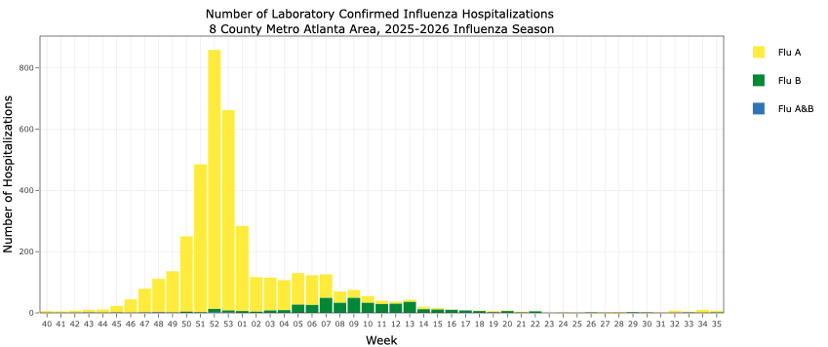
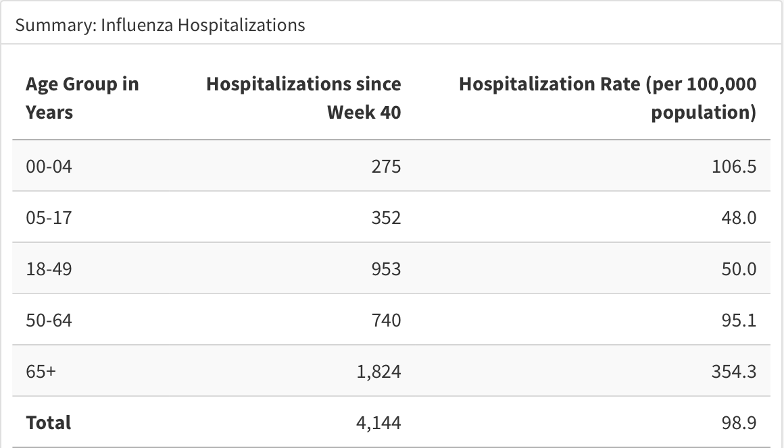
Current Season Trends – Influenza Hospitalizations ​

Slide 13
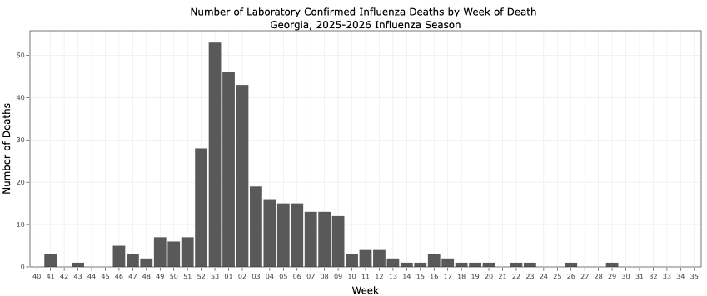
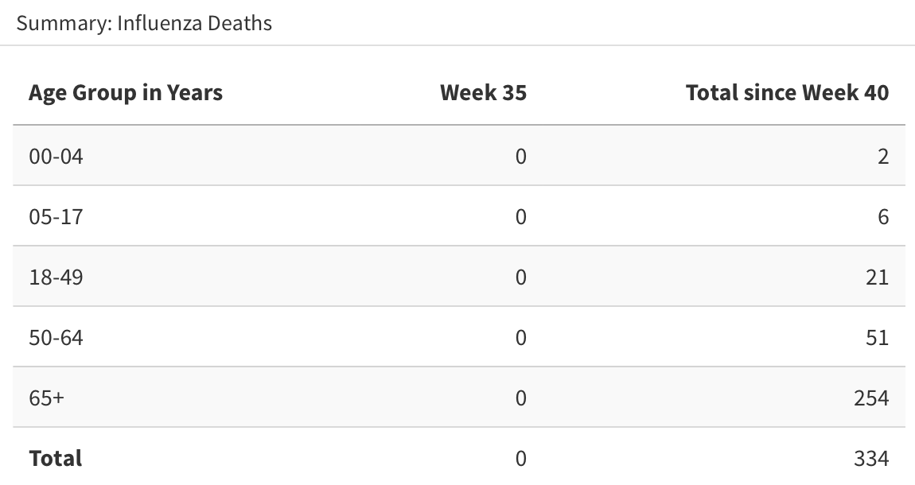
Current Season Trends: Influenza-Associated Deaths

Slide 14
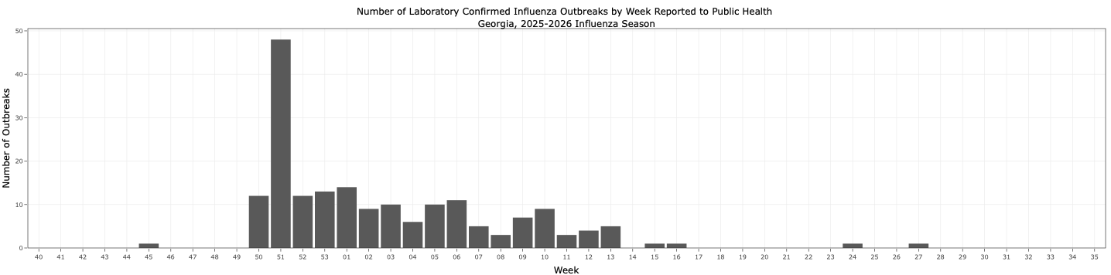
Current Season Trends – Influenza Outbreaks
Most common outbreak setting types for the 2025-2026 season:
  Schools – accounts for 2/3 of all reported influenza outbreaks
  Long-Term Care Facilities – accounts for 1/3 of all reported influenza outbreaks

Slide 15
Infection Control Guidance
Influenza and RSV vaccination
  Promote immunization among eligible HCP, residents/patients, and caregivers
  Follow current ACIP/CDC recommendations for vaccination
Practice physical distancing
  Separate symptomatic patients or residents from others and exclude from communal activities
  Reduce crowding in shared spaces
Implement screening and triage procedures
  Screen for respiratory symptoms & establish procedures for patients/visitors to report symptoms
Practice respiratory hygiene and cough etiquette
  Encourage covering cough/sneezes
  Reinforce hand hygiene after contact with respiratory secretions
  Maintain soap and disposable towel supplies at sinks

Slide 16
Infection Control Guidance
5. Use source control
  Mask symptomatic individuals
6. Use appropriate PPE
  Apply Transmission-Based Precautions based on risk and suspected infection
7. Optimize ventilation
  Ensure air handling systems are properly functioning and keep air vents unobstructed
8. Cleaning & disinfecting
  Disinfect high-touch and high-traffic areas regularly
  Properly disinfect reusable equipment after each use

Slide 17
Testing and Treatment for Influenza
Test HCP and residents with signs and symptoms of respiratory illness
Provide recommended antiviral treatment immediately for symptomatic individuals who have confirmed or suspected influenza infection and antiviral PEP for exposed residents in units or wards with influenza when an active outbreak is occurring
For outbreak control, CDC recommends antiviral chemoprophylaxis of exposed residents with oral oseltamivir or inhaled zanamivir for a minimum of 2 weeks and continuing up to 1 week after the last known case was identified.
Unvaccinated HCP: Antiviral PEP can be offered for HCP caring for residents at high risk for influenza complications.
Newly vaccinated HCP: May consider prophylaxis for up to 2 weeks after vaccination while immunity develops.

Slide 18
Weekly Reporting​
Georgia DPH Webpage: Influenza report updated weekly on Fridays (except for holidays), reflecting data through the preceding Saturday​
Data includes those from CDC and EIP partners, along with SendSS surveillance data
Report can be found at: https://dph.georgia.gov/flu-activity-georgia ​
​
Email us with the Subject “Subscribe to Flu Report” to receive alerts of published reports​:
Sayna.patel@dph.ga.gov and samantha.mcchesney@dph.ga.gov ​

Slide 19
Acknowledgements
Georgia Department of Public Health Internal Team Partners ​
Georgia Public Health Laboratory (GPHL)​
Centers for Disease Control & Prevention (CDC)​
Emerging Infections Program (EIP) Partners​
District and County Health Departments​
Hospital Infection Preventionists and Clinical Laboratories​
Medical Examiners and Coroners​
​
Thank you to all partners who contribute to viral respiratory disease surveillance and reporting.

Slide 20
Questions
For additional information, please contact:
Sayna Patel, MPH
Influenza Surveillance Coordinator
sayna.patel@dph.ga.gov
Samantha McChesney, MPH
VRD Sentinel Surveillance Epidemiologist
Samantha.mcchesney@dph.ga.gov
Amanda Feldpausch, DVM, MPH
Deputy State Epidemiologist
amanda.feldpausch@dph.ga.gov

Slide 21
Appendix/ Resources
Georgia Influenza Activity + What You Need to Know https://dph.georgia.gov/flu
Viral Respiratory Toolkit for Nursing Homes: https://www.cdc.gov/long-term-care-facilities/hcp/respiratory-virus-toolkit/index.html
Preventing Transmission of Viral Respiratory Pathogens in Healthcare Settings https://www.cdc.gov/infection-control/hcp/viral-respiratory-prevention/index.html

